Slide 1
Analysis Tourism Destination
Retno Wisnu Murti

Slide 2
Problem
Indonesia is a country with a plethora of captivating attractions, ranging from beautiful mountains and serene beaches to culturally rich historical landmarks and much more. The growth in tourist arrivals in 2023 has shown an increase, meeting and even surpassing the government's targets. However, compared to other countries in ASEAN, the growth of tourism in Indonesia remains relatively slow.

Slide 3
Overview Dataset
This dataset is a collection of tourist attractions in 5 major cities in Indonesia, namely Jakarta, Yogyakarta, Semarang, Bandung, and Surabaya. It displays user ratings for these tourist destinations.
The dataset consists of 4 files:
tourism_with_id.csv: Information about tourist attractions in the 5 major cities in Indonesia.
user.csv: Information about user data with a total of 300 users.
tourism_rating.csv: Information about users, places, and ratings for tourist destinations.
Link Dataset : https://www.kaggle.com/datasets/aprabowo/indonesia-tourism-destination

Slide 4
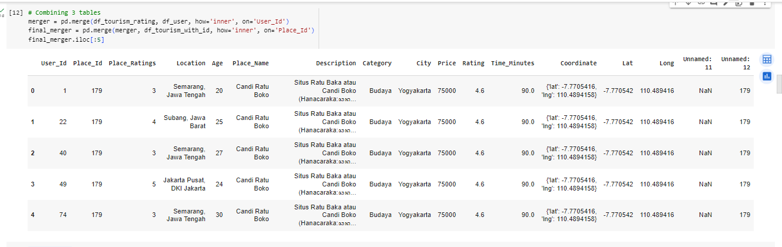
Exploratory Data Analysis (EDA)
Doing EDA using python, to initially merger 3 tables into one

Slide 5
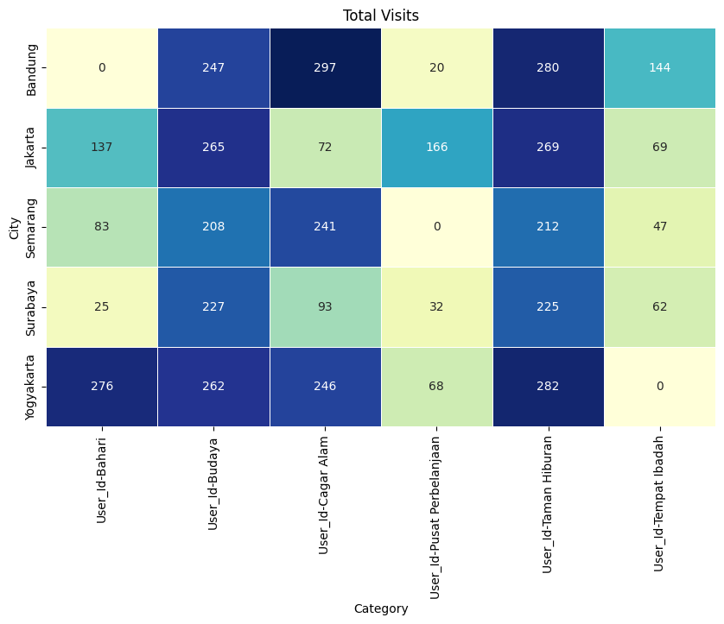
Total visits to each city by category
Based on the destination cities, the top 3 categories with the highest tourist visits are as follows:
Natural Reserve category in Bandung (297 visits)
Amusement Park category in Yogyakarta (282 visits)
Amusement Park category in Bandung (280 visits)
There are 3 destination categories that are not visited by tourists:
Maritime category in Bandung
Shopping Center category in Semarang
Religious Places category in Yogyakarta

Slide 6
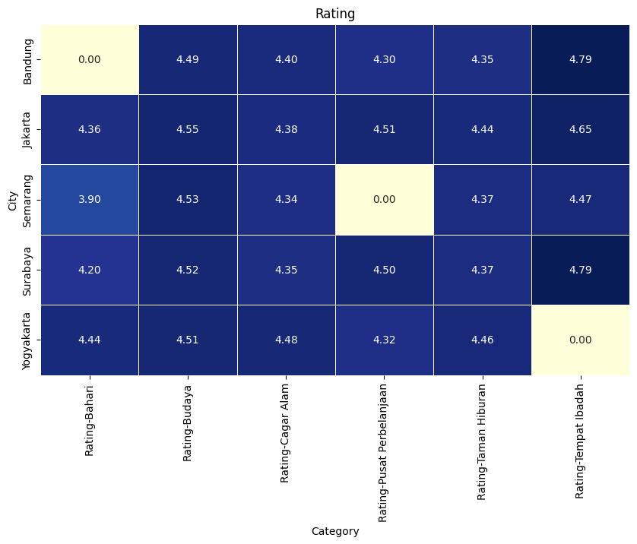
Rating to each city by category
Based on the destination cities, the top 3 categories with the highest ratings are as follows:
Religious Places category in Bandung (4.79)
Religious Places category in Surabaya (4.79)
Religious Places category in Jakarta (4.65)
There are 3 destination categories that have ratings but are not visited by tourists:
Maritime category in Bandung
Shopping Center category in Semarang
Religious Places category in Yogyakarta

Slide 7
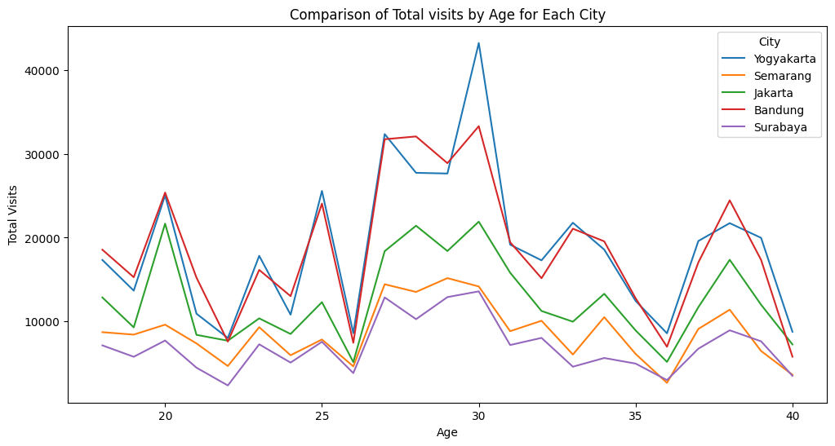
Comparison of Total visits by Age for Each City
The average number of tourist visits is highest at the age of 30. However, there is a significant decline at the ages of 26, 36, and 40.
In the cities of Yogyakarta and Bandung, the average tourist visits are high, but there is also a very significant decline for certain age groups.

Slide 8
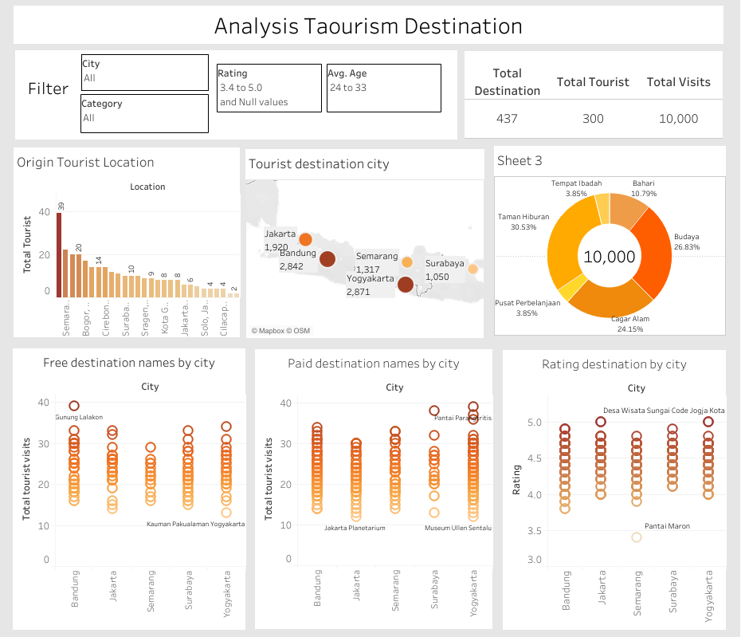
Dashboard Tableau
Link : Dashboard Tableau

Slide 9
Insight
Based on the analysis using Python and visualization using Tableau, several insights can be derived:
Yogyakarta and Bandung are the favorite cities for tourist destinations, with the highest average number of visits. Meanwhile, Surabaya, despite having visitors in each tourism category, has a relatively low number of visits, making it the city with the lowest tourism traffic.
Semarang has the lowest ratings despite having a decent level of visits. Therefore, there is a need for an improvement in the quality of tourism in Semarang to increase the number of tourist visits.
The Natural Reserve category has the highest number of visits, with many tourists from major cities choosing this category to escape the hustle and bustle of urban areas. Therefore, implementing proper maintenance and improvements can enhance both the rating and the number of visits.
High ratings for Religious Places can increase the number of visitors, especially if events are held at these locations, such as lectures featuring renowned speakers or other activities.

Slide 10
Insight
Based on the analysis using Python and visualization using Tableau, several insights can be derived:
The number of visits to free destinations (3,182) is less than that of paid destinations (6,818). This suggests that tourists are willing to spend money to enjoy the attractions they want to visit.
However, paid attractions have a lower rating compared to free destinations. Therefore, improvements and maintenance of facilities or paid attractions should be carried out to be comparable to what is paid for and to satisfy the visiting tourists, leading to an increase in visits.
There are 4 free destinations with a rating of 5, namely Culinary Tour Pacenongan, Freedom Library, Sungan Code Yogyakarta Village, and Kauman Pakualam Yogyakarta. There is a need for more promotion to increase visits to these destinations. Due to their high ratings, these destinations deserve more attention.
In summary, it is suggested to invest in the improvement of paid attractions to enhance their ratings and to focus on promoting the free destinations with high ratings to attract more visitors.

Slide 11

Thanks!
https://www.linkedin.com/in/retno-wisnu-murti/
https://retnomurti11.wixsite.com/retnowisnumurti
WIX
https://github.com/retnowm
Do you have any questions? retnomurti11@gmail.com

